Slide 1
Medicare Application
Team members :
1- Rahma Hussein
2- Sara Atef
3- Omneya Ahmed
4- Mohamed Ayman
5- Mohamed Abdallah
6- bassant abdelhamed

Slide 2
Problem statement
In our country, most clinics and hospitals have not embraced the new technologies that can improve their management and profits.as a result, most of them use analogue systems to capture and manage data. Large space usage. Use of paper to record data requires large space for storage over time. This can be seen in many places where analogue systems are in use. Inefficient back up methods. Old systems especially that which are analogue do not provide effective ways to back up data and as a result data can be permanently lost in the event data is damaged or misplaced. This may lead to the collapse of the institution. The application also helps to save time and makes it easier for the patient to reach the nearest doctor. It also helps the patient to find a doctor at the right price for him and facilitates the booking process at the time that suits the patient.

Slide 3
Objectives of the system
Justification of the computerized system the main aim of a hospital or any clinical organization is to maximize profits. The software product will help in achieving this in the following ways.
• Reducing operational cost.
• Curbing fraud by the employees.
• Increased efficiency and effectiveness.

Slide 4
Features
The user can reservation with the doctor from home
Can chosen the best doctor for his state
The admin can change the Database
Reduce the time for going to reservation in the clinic

Slide 5
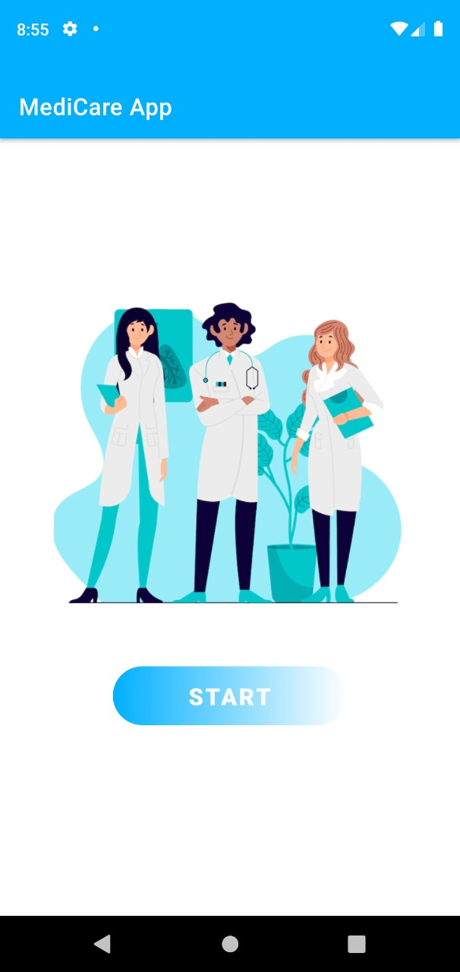
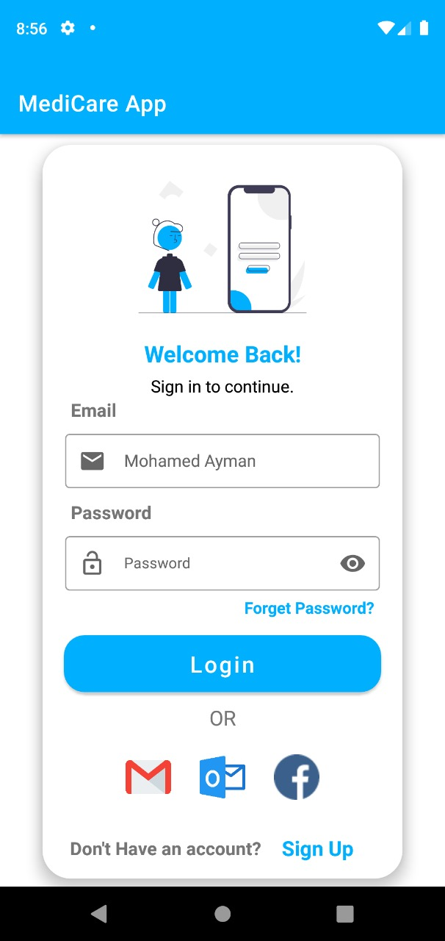
First we click to start application ,And after that we go to login page And login as admin to change something or login as user

Slide 6
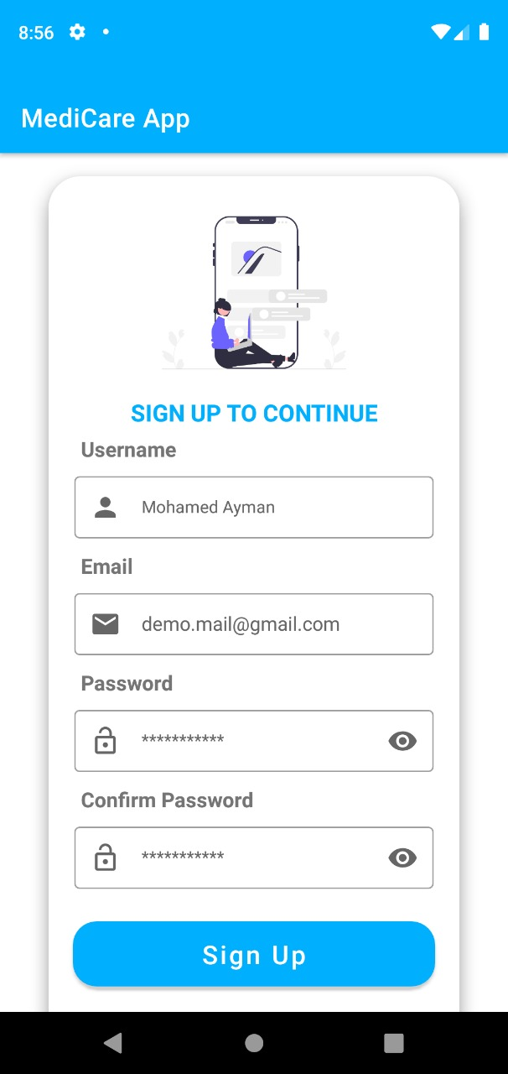
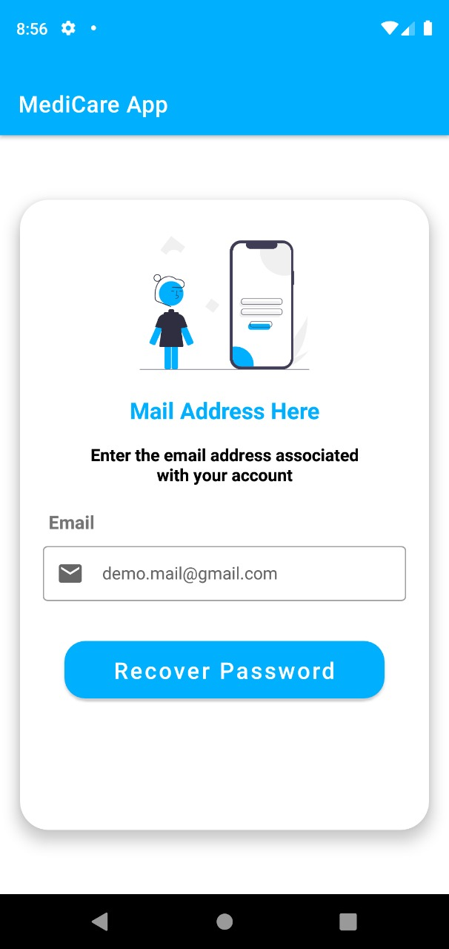
1. A sign up page for new users 2. If the user forgets his password A feature that helps the user to restart his password

Slide 7
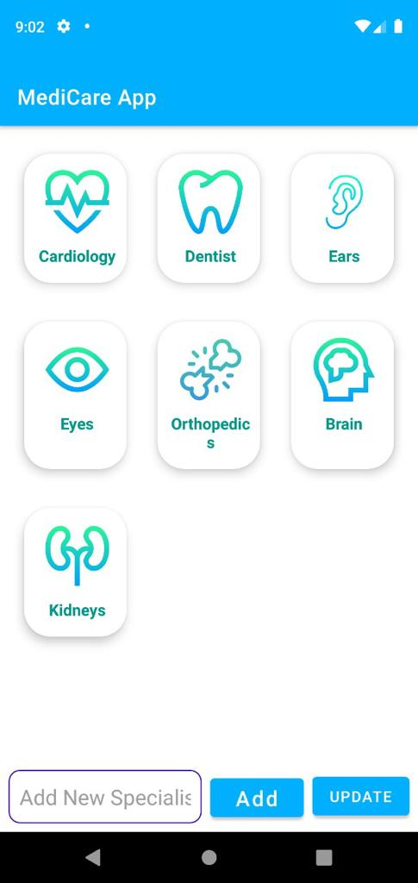
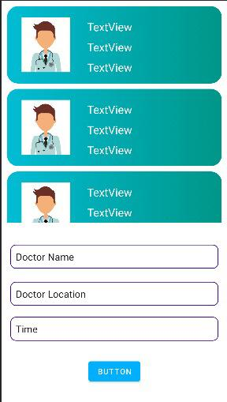
If the user logged in as an admin it takes him to the category page and it takes him to the doctors page .
The category page helps the admin to choose which category he’s looking for and when he chooses the suitable category, the application takes him to the next page which is the Doctor’s page.
When the admin updates or add new info about the category or the doctor page, this information is stored in the database

Slide 8
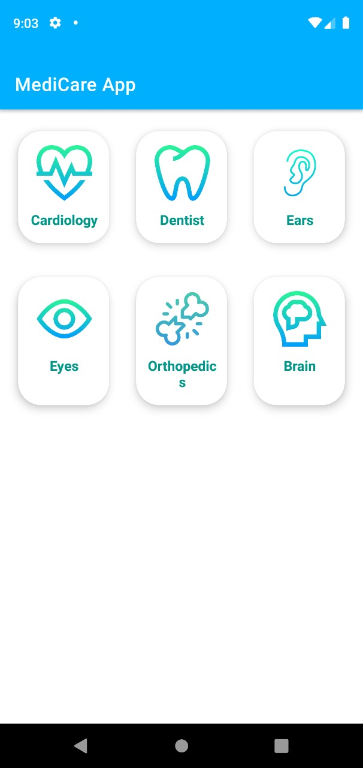
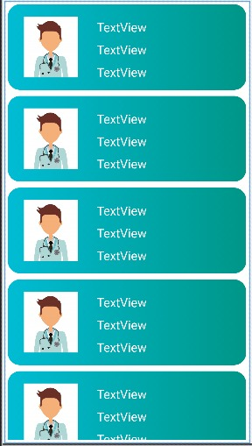
If he entered as a user, it will take him to the category page then view him a recycler view for the doctors who have profiles for the application.

Slide 9
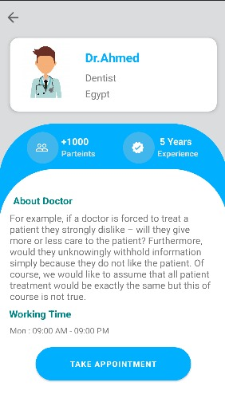
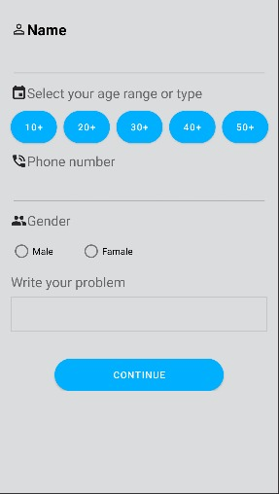
Info about chosen doctor and taking an appointment and put their information and submuit it to reservation

Slide 10
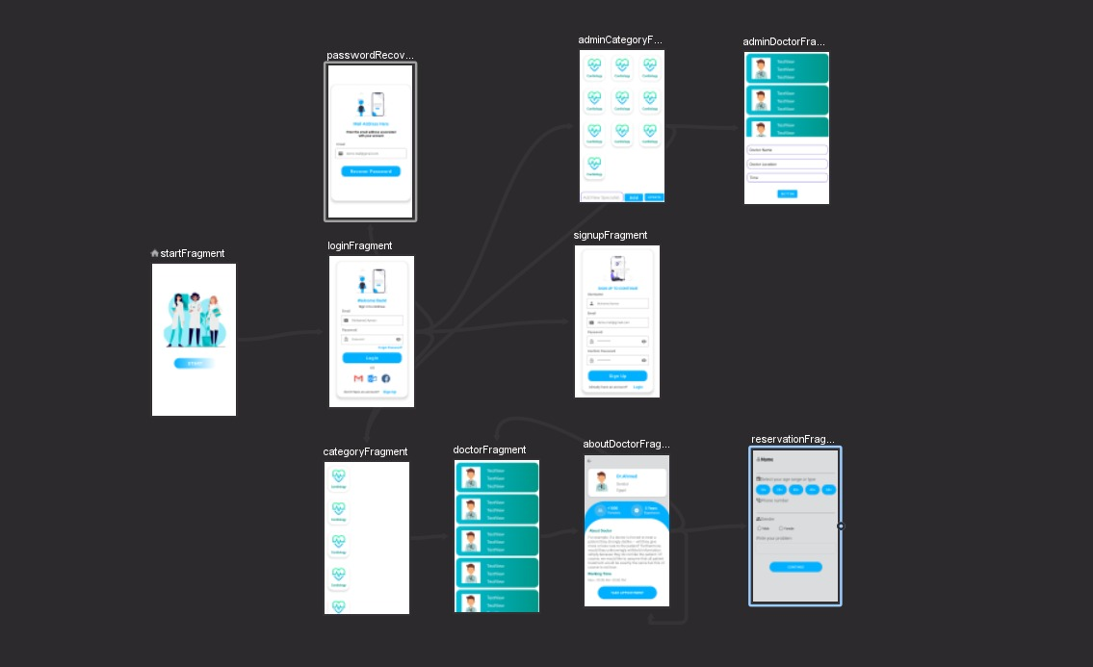
The application navigation

Slide 11
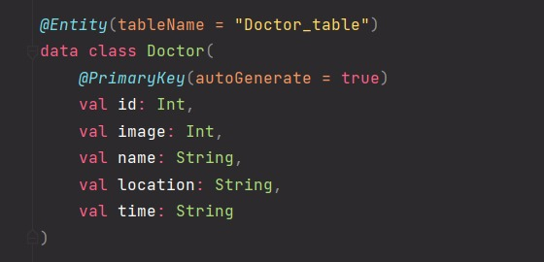
The Database

Slide 12
Thank you

